Slide 1

Searching for (non-Solar) Data in Heliophysics
Eric Grimes
NASA GSFC/ADNET Systems
https://spdf.gsfc.nasa.gov

Slide 2
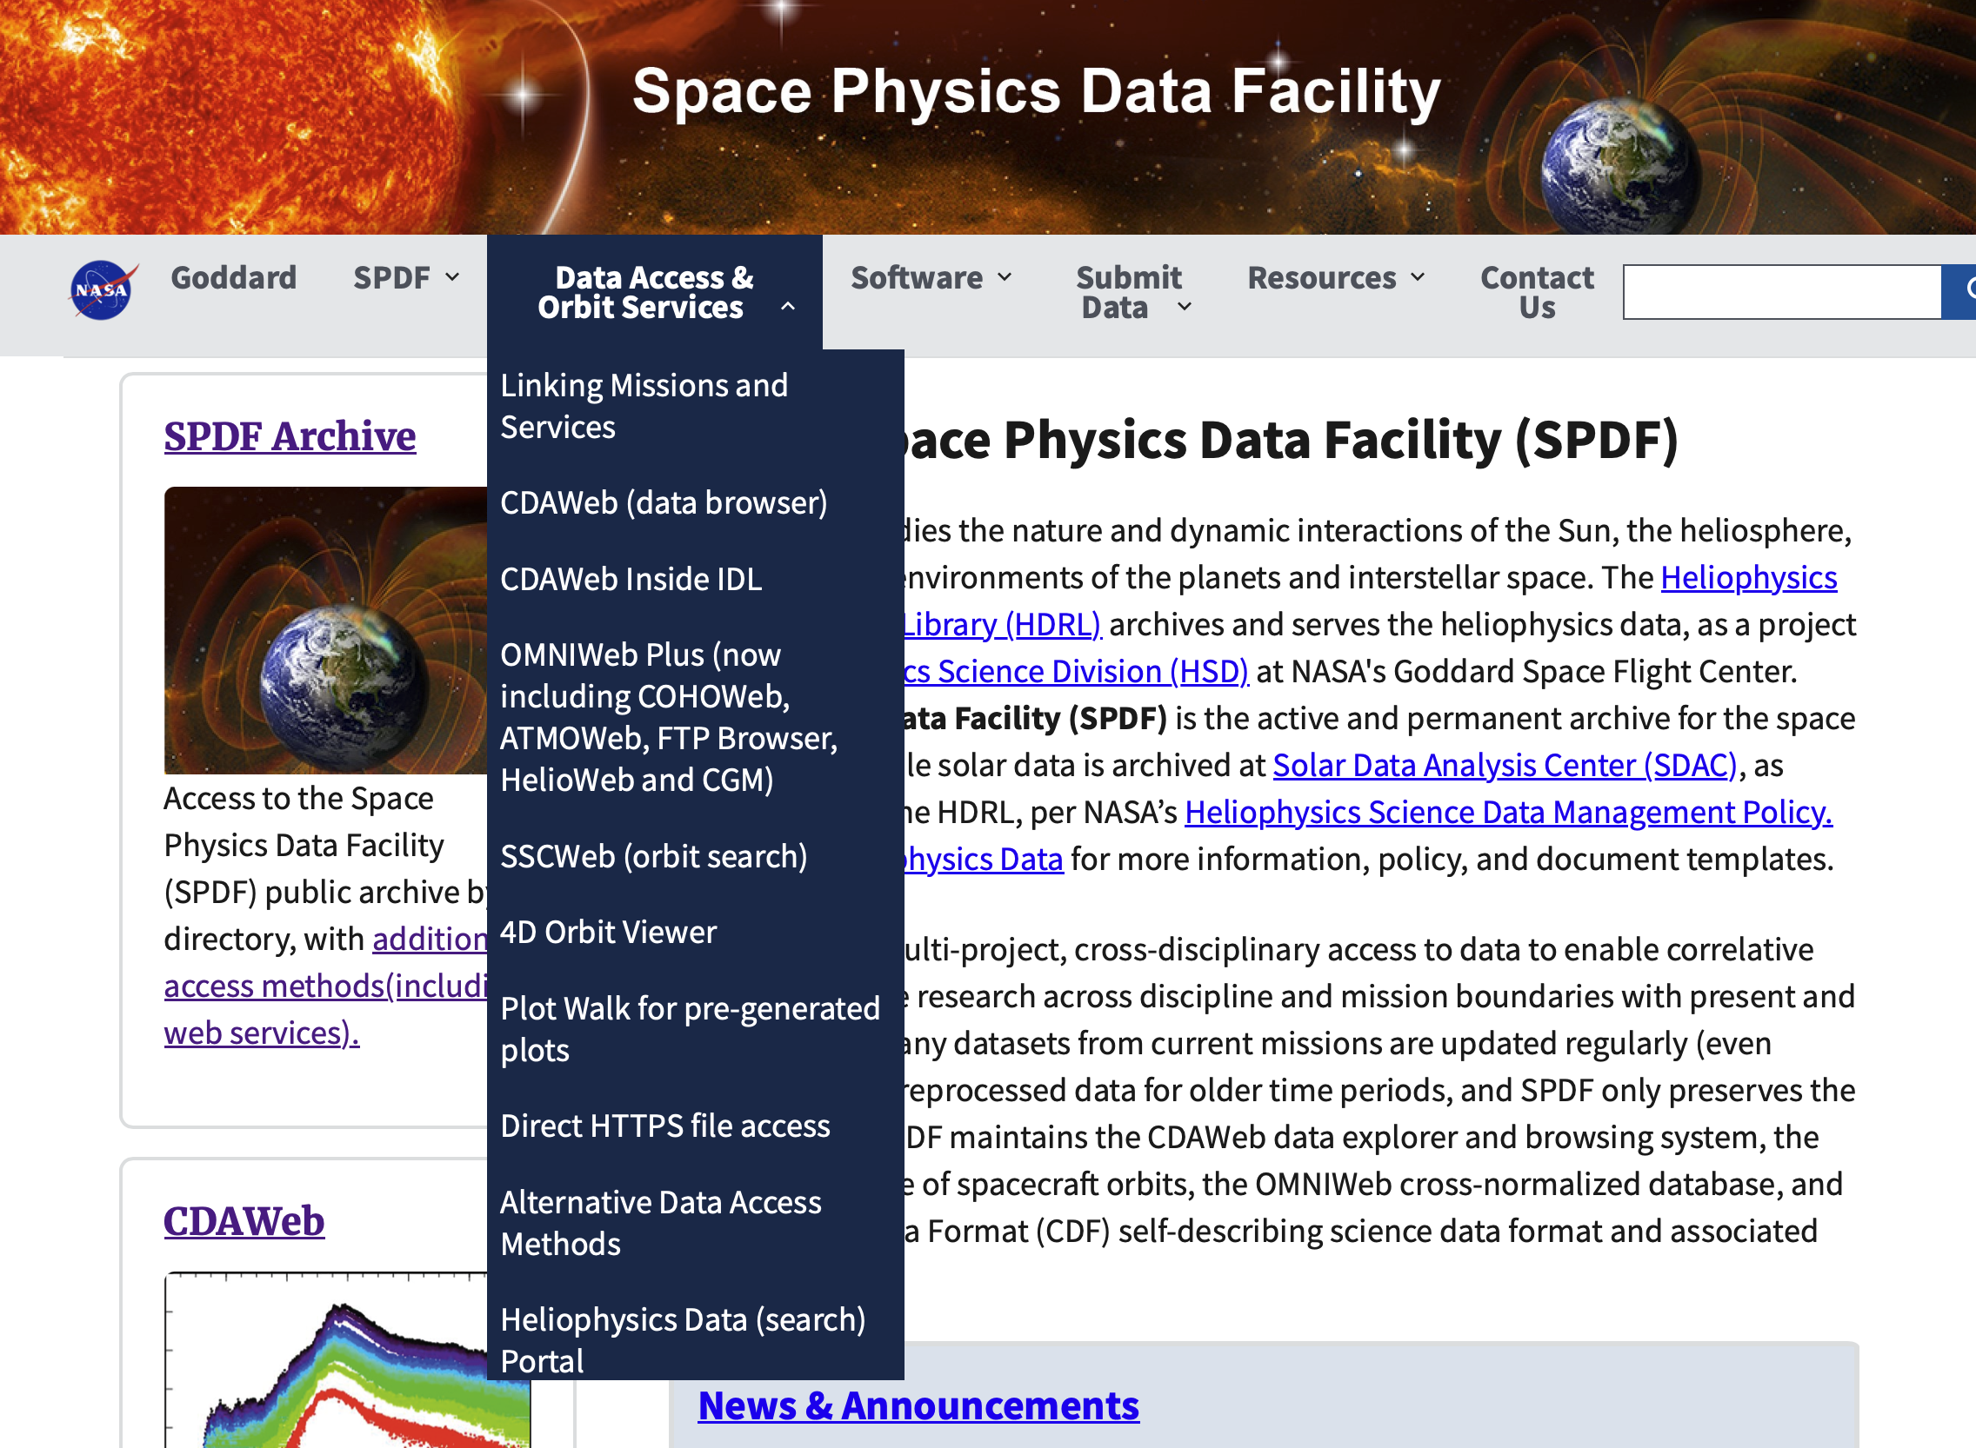
Searching for Data

Slide 3
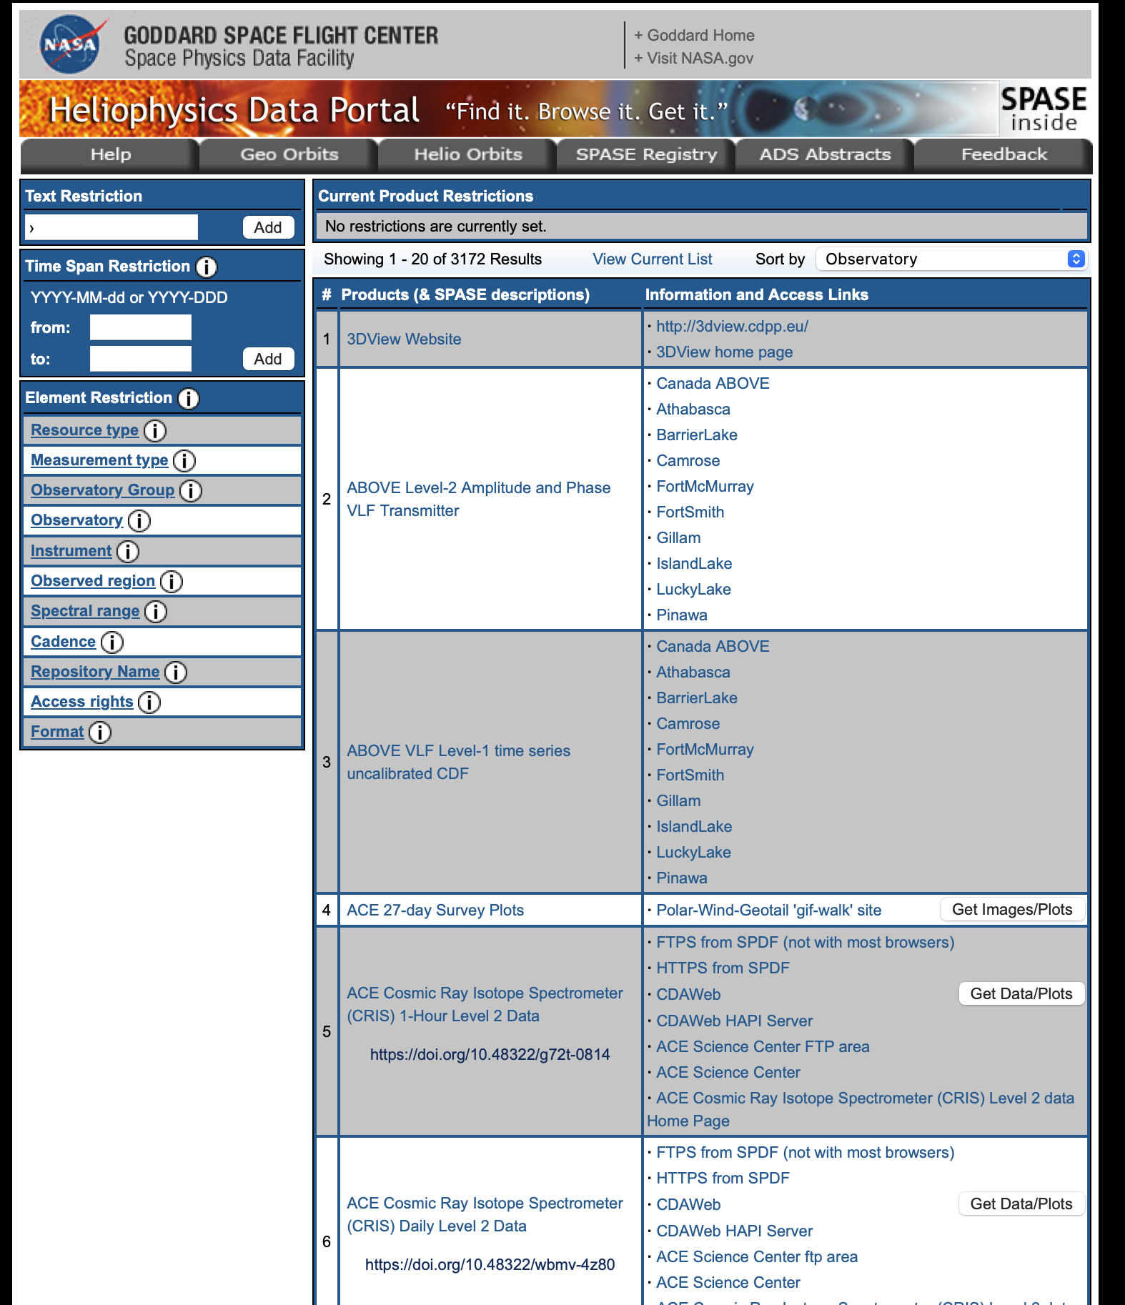
Searching for Data
See:
https://heliophysicsdata.gsfc.nasa.gov
This contains a large number of datasets; in addition to the “Text Restriction” input box, you’ll probably want to use the “Element Restriction” section to limit the output
This page contains dataset names, and where to find the data

Slide 4
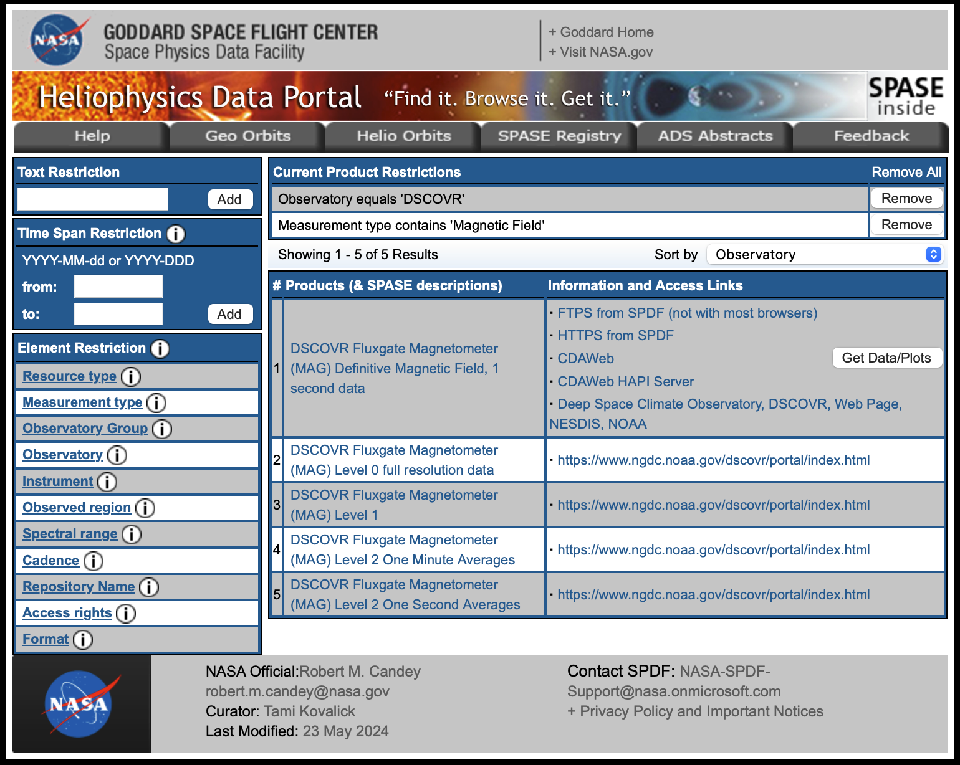
Searching for Data
For example, if you set the “Observatory” to “DSCOVR” and the “Measurement type” to “Magnetic Field”, you’ll find all of the B-field datasets for the DSCOVR mission
Click on the product name to go to the SPASE description
Note: include quotes in the text restriction text box for exact matches to the full string

Slide 5
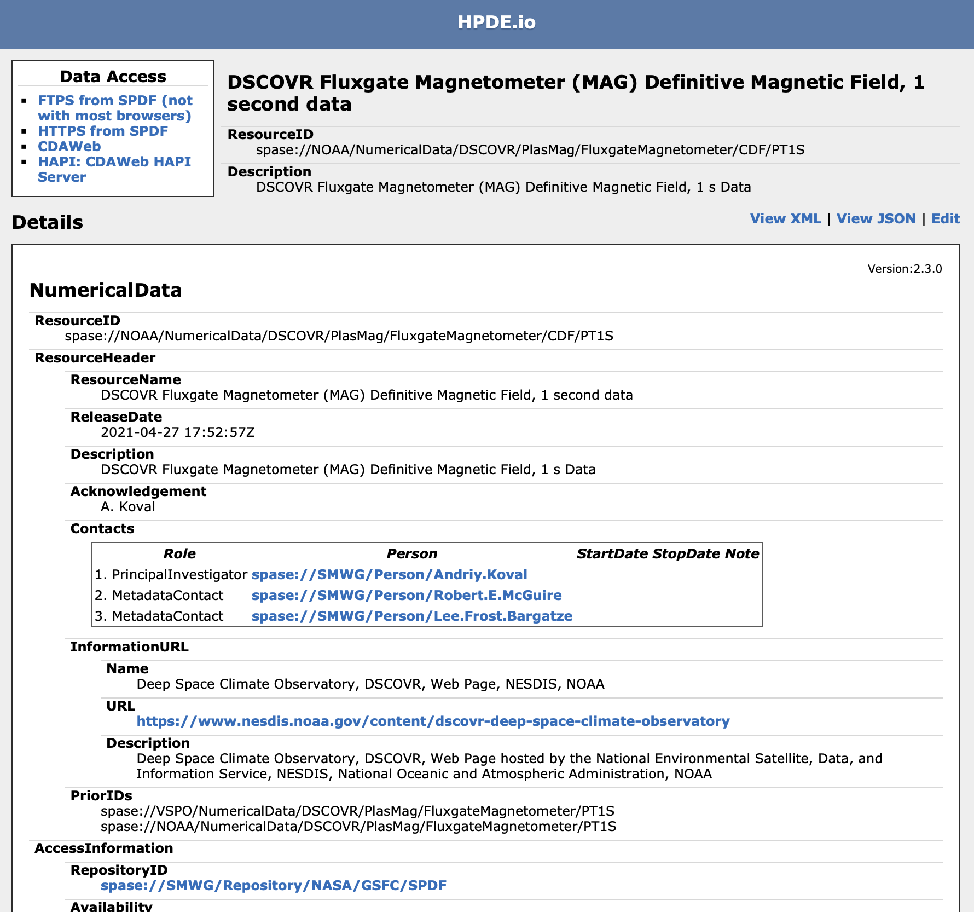
Searching for Data

Slide 6
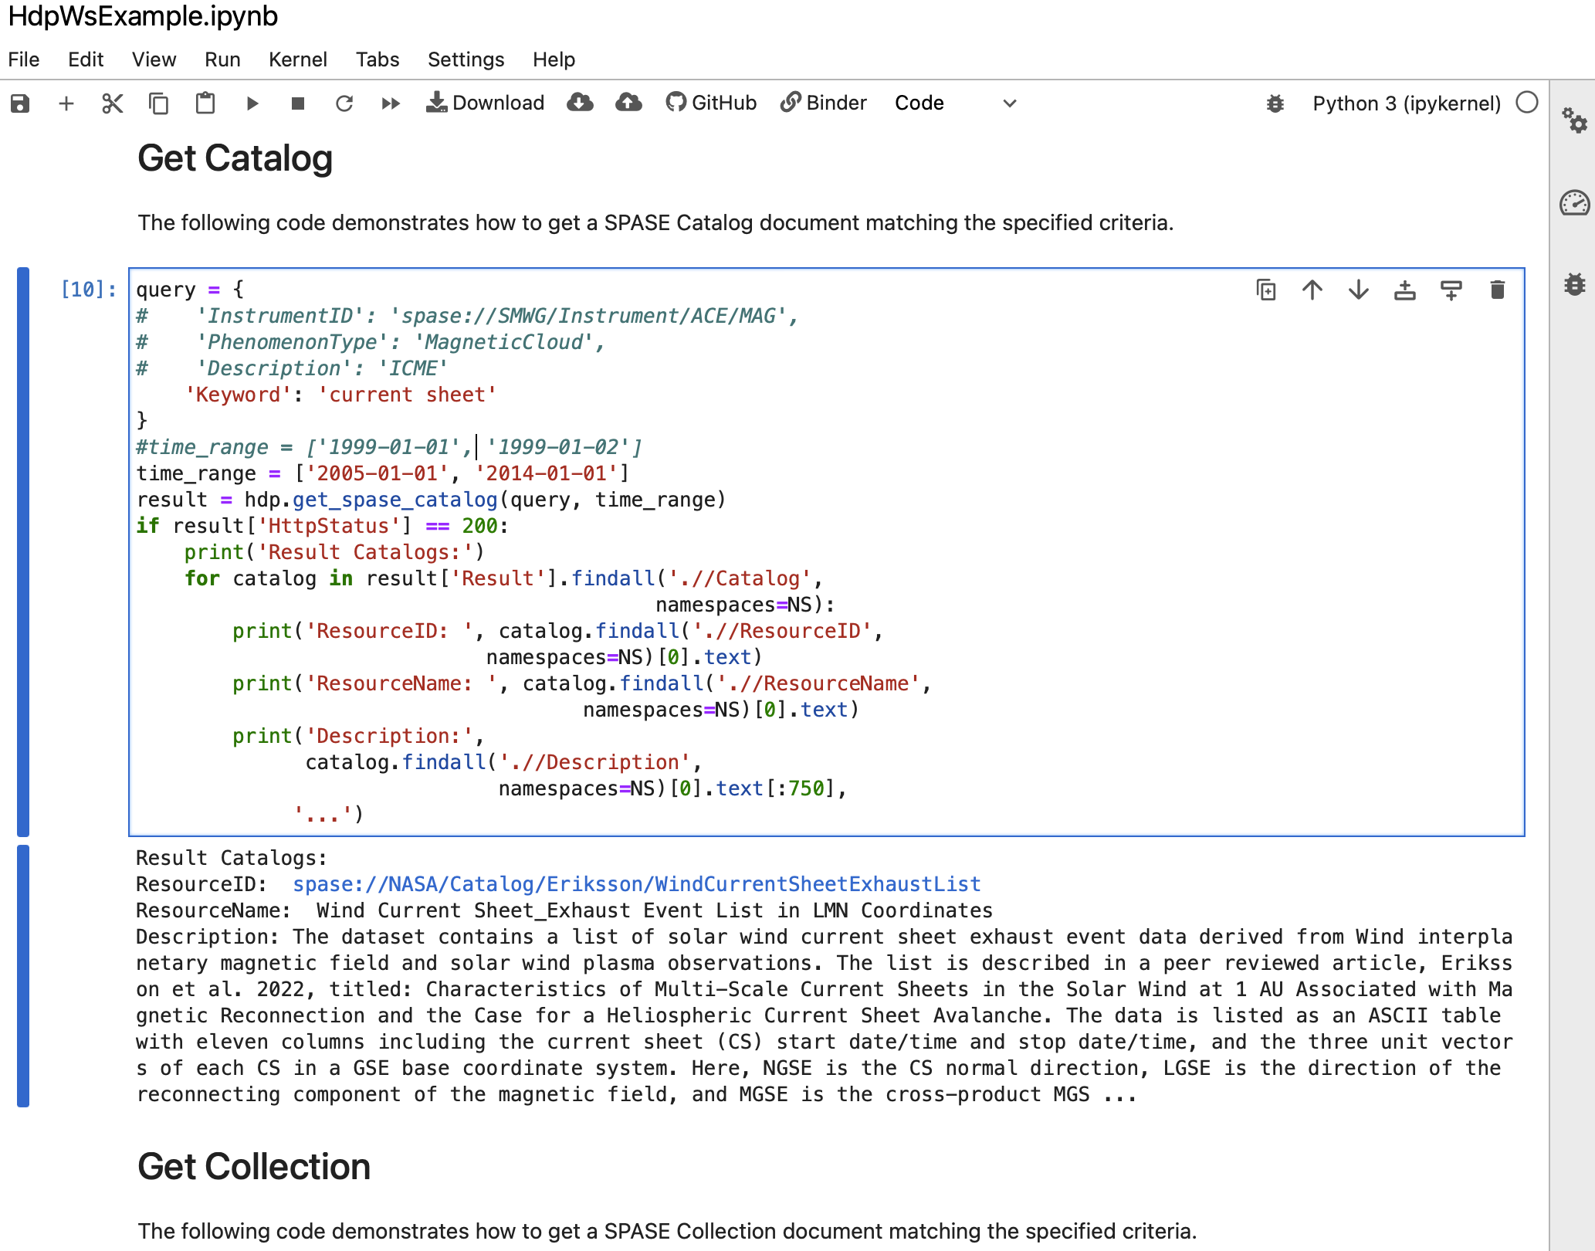
Searching for Data (from Python)
There’s a library for searching the HDP web services for datasets at:
https://heliophysicsdata.gsfc.nasa.gov/WebServices/

Slide 7
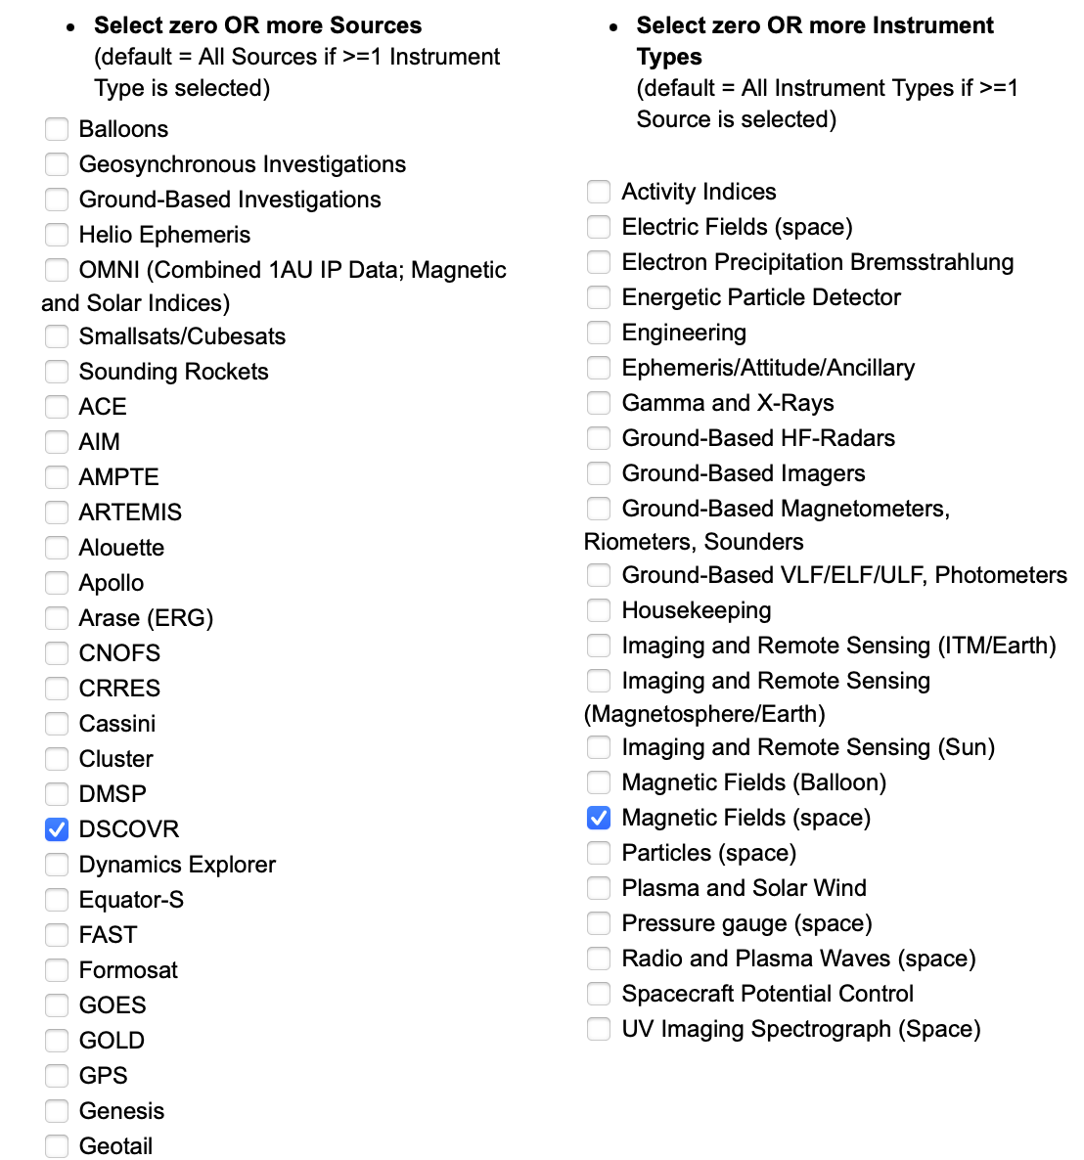
Accessing the Data

Slide 8
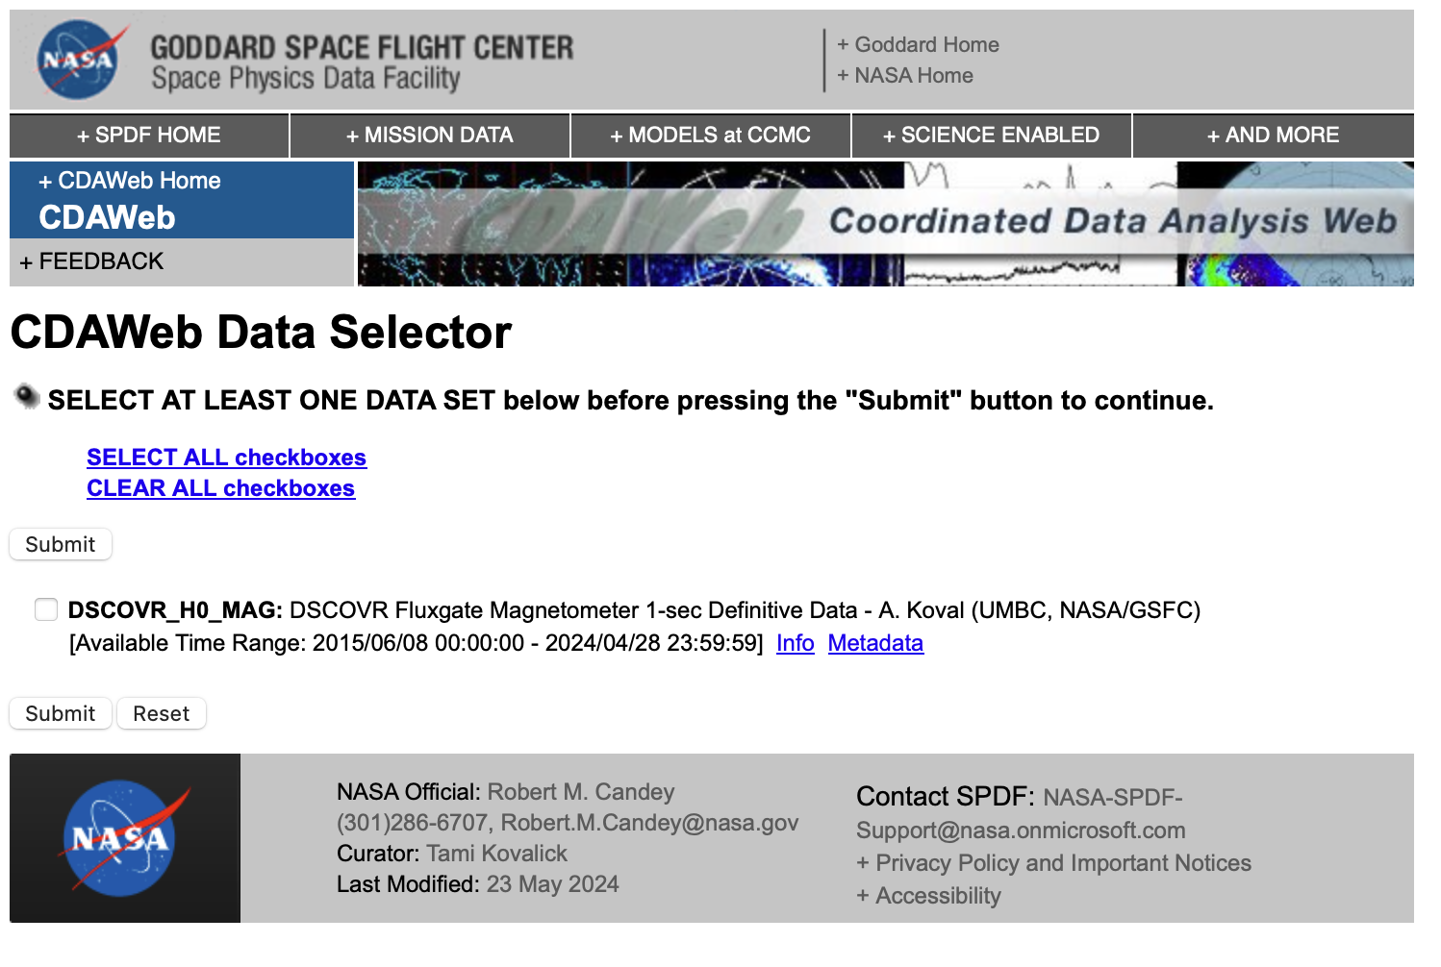
Accessing the Data
Select the dataset to create browse plots
OR
Click “Info” for info on the dataset, as well as an example of how to access the data from Python

Slide 9
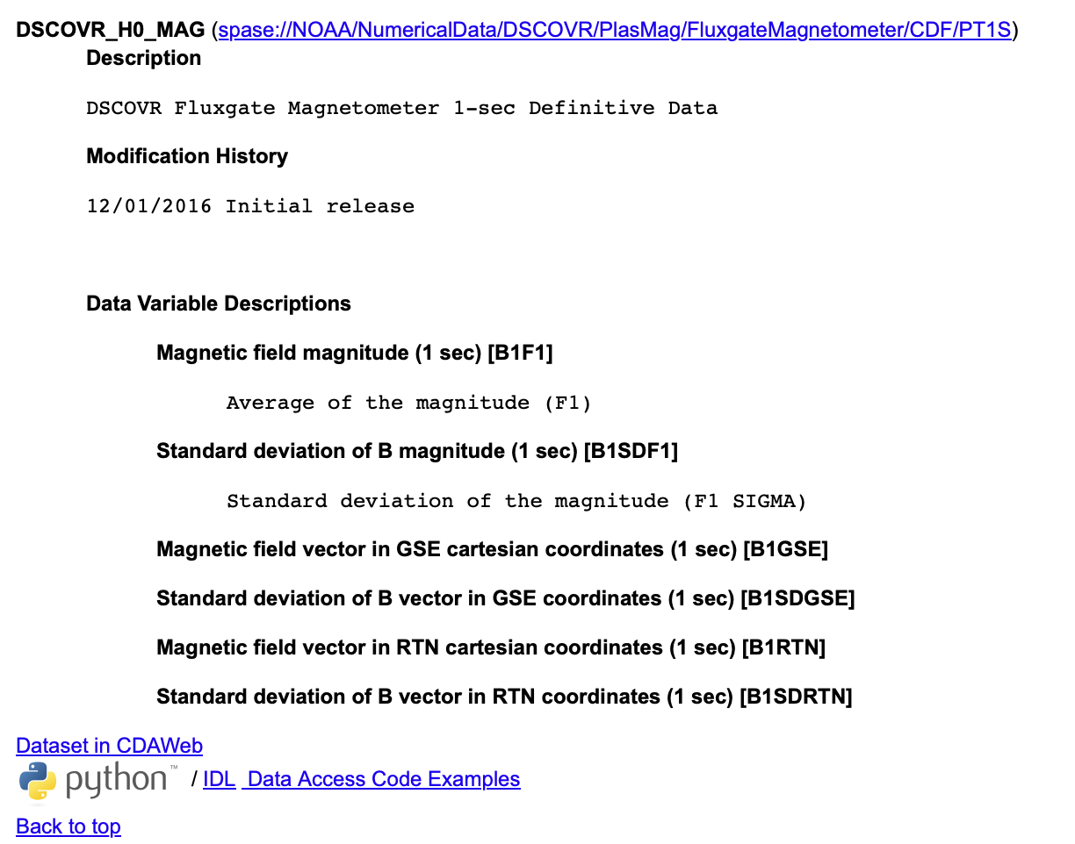
Accessing the Data
Clicking “Data Access Code Examples” takes you to a Python example

Slide 10
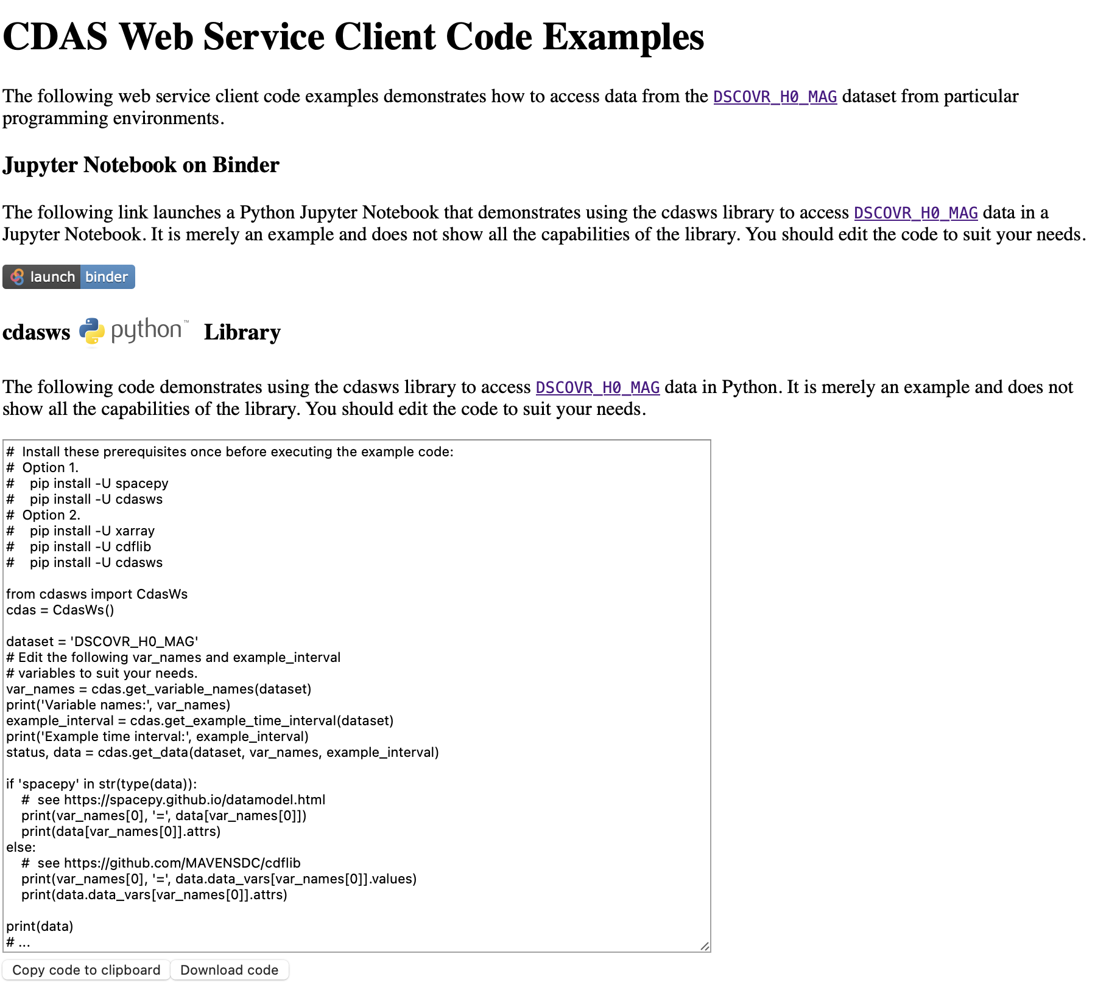
Accessing the Data
Click “Launch Binder” to open a Jupyter notebook showing how to access these data
OR
Copy+paste the script into your terminal

Slide 11
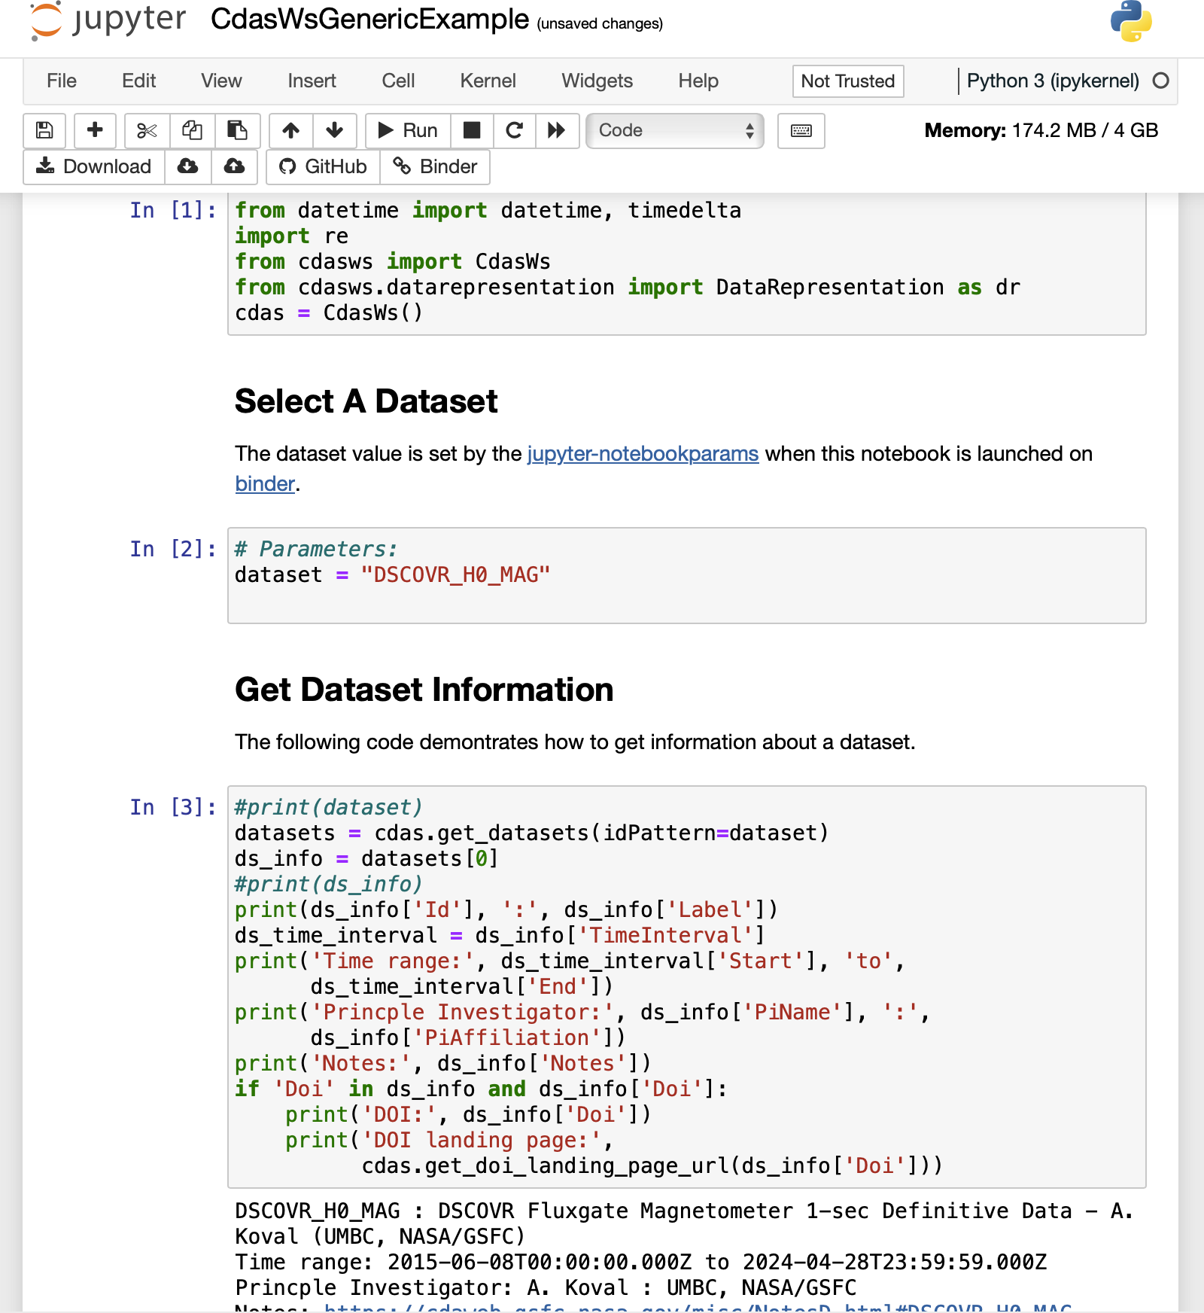
Accessing the Data
This example shows the Jupyter notebook showing how to access DSCOVR MAG data from CDAWeb

